Slide 1
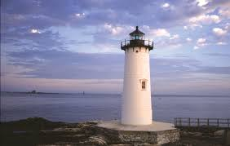

Project Lighthouse
A Business Decisions Modelling Factory
Thank you to:
David Chuang – PowerPoint layout
Faisal Abu-Qube – UI for App mockup

Slide 2


Slide 3


Slide 4


Slide 5
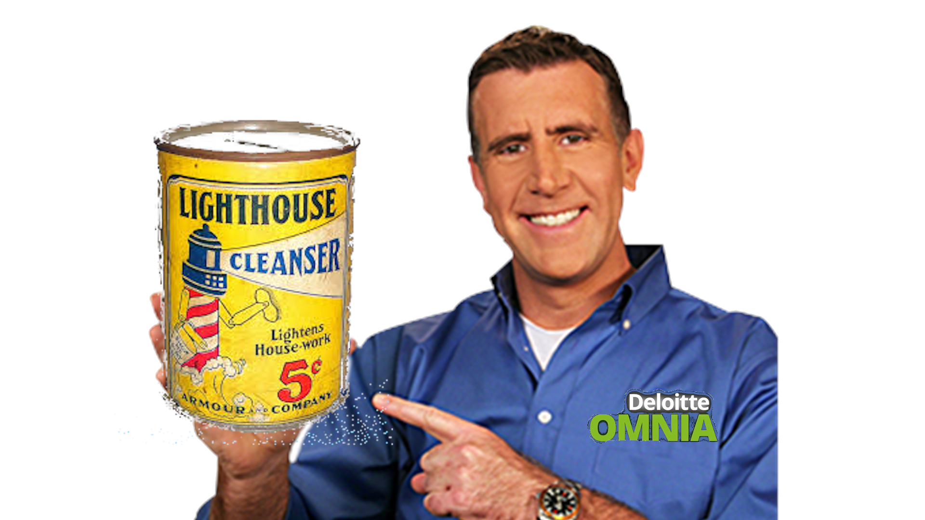
Use Project Lighthouse today!!!

Slide 6

Project Lighthouse
A Business Decisions Modelling Factory
Thank you to:
David Chuang – PowerPoint layout
Faisal Abu-Qube – UI for App mockup

Slide 7



Project Lighthouse
Nicholas Hoell
Manvi Jain
Debraj Das

Slide 8
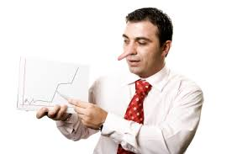

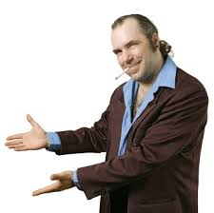
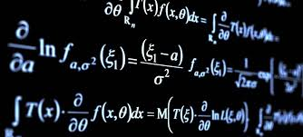
Executive Summary
A product which allows enterprises to make best-in-time investment decisions using AI insights derived from leading financial instruments.
✓

Slide 9




The Model idea may be great but…
Reliable data must be easily available
train models
The product must be sellable
economically viable
The business case must be simple
realistic implementation
The product must have longevity
long shelf life

Slide 10
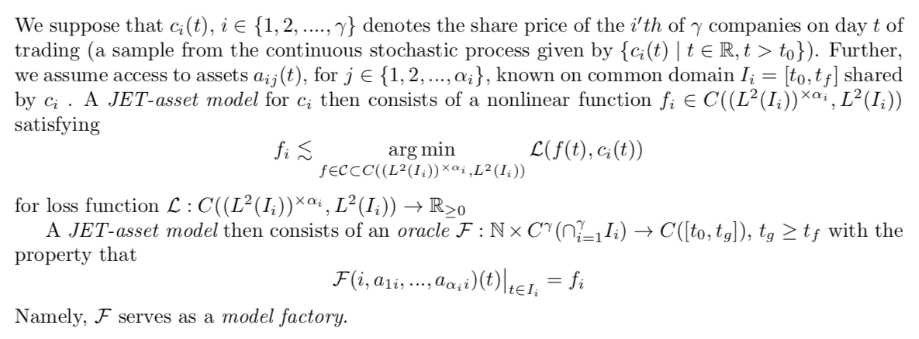
The Basic Model Factory: Technical Details

Slide 11


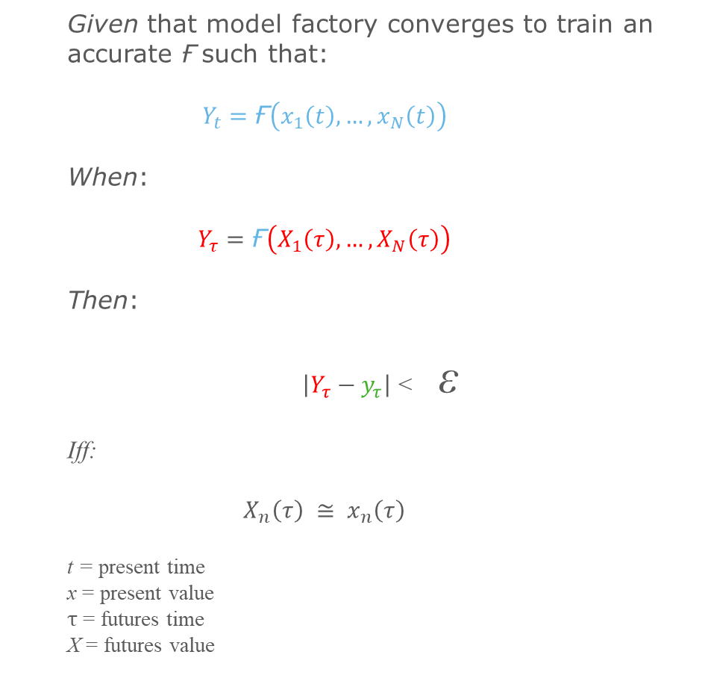



Theory: The Intuition
Given that model factory converges to train an accurate $\text{Ғ}$such that:
$$Y_{t}=\text{Ғ}\left(x_{1}\left(t\right),…,x_{N}\left(t\right)\right)$$
When:
$$Y_{τ}=\text{Ғ}\left(X_{1}\left(τ\right),…,X_{N}\left(τ\right)\right)$$
Then:
$\left|Y_{τ}−y_{τ}\right|$< ε
Iff:
$$X_{n}\left(τ\right) ≅ x_{n}\left(τ\right)$$
t = present time
x = present value
$τ$ = futures time
X = futures value
Y18
Y15
Y14
Y1
x1
x14
X15
X18

Slide 12


Why Us? Use Cases
Business Decisions
What would a human ask?
What would AI ask?
When is a good time to make large capital investments? | Should my business buy that new factory in 6 months, or is 12 months better? Is this an underserved risk that privates won't take on? | What hidden futures trends are probable impact drivers on similar investments?
Should my business push for financing now or next year? | Are interest rates low now? fixed or floating? Is there a liquidity bubble happening? | What’s the correlation with interest rates on Wheat? Yes: use Futures outlook as proxy
Google approached with an offer to acquire my startup! What should I do? | Is April a good time to sell my business, or is November better? | Does the trend of short-dated predicted outcomes display implicit concavity?
Is this a good time to launch my green photonics startup? | If I wait to launch will my competitors get a permanent edge? Where is inflation happening? Which inflation am I sensitive to? | What do titanium futures indicate about growth in new photonics sourcing?

Slide 13
The Case
Ye Olde Local Pizza Restaurant
The Business
The Proxy
You’re like Dominos
The Solution
If you can accurately quantify it, you can now use it to calculate

Slide 14
App Mockup

Slide 15
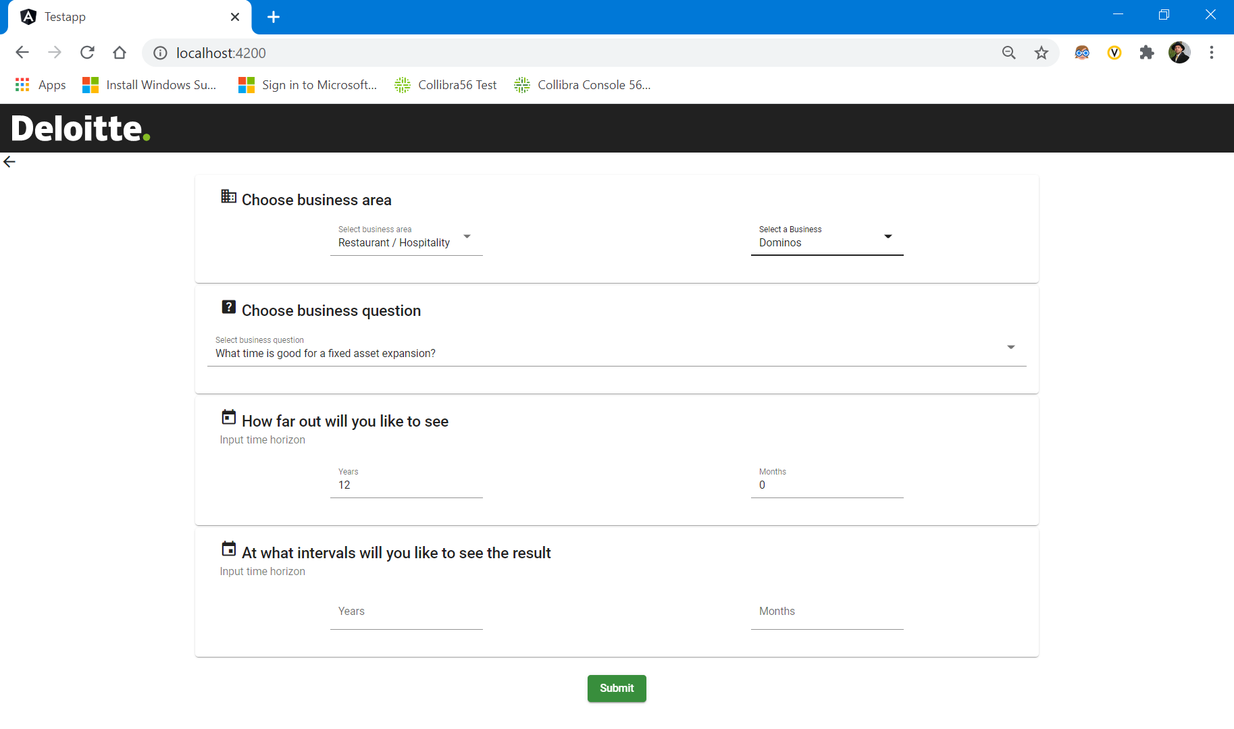

Slide 16
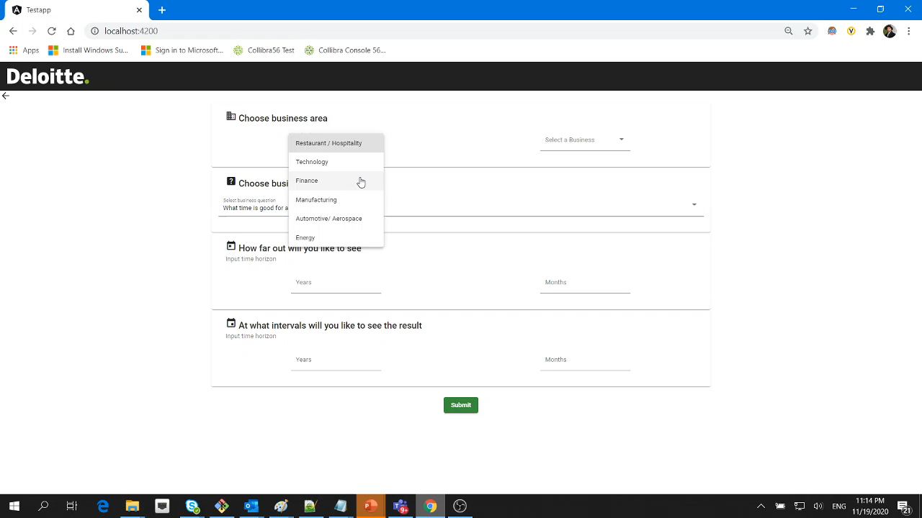

Slide 17
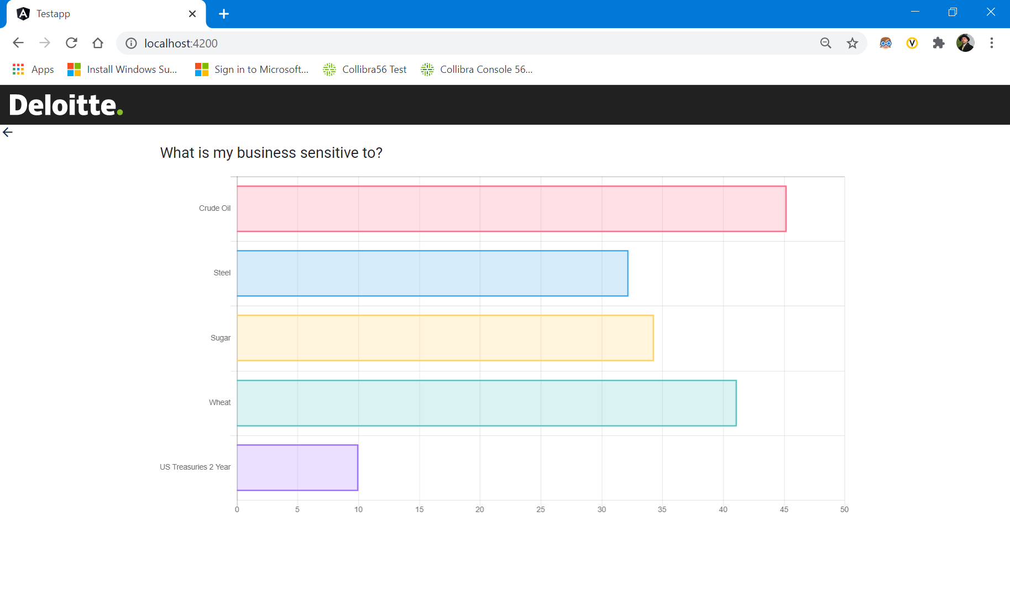

Slide 18
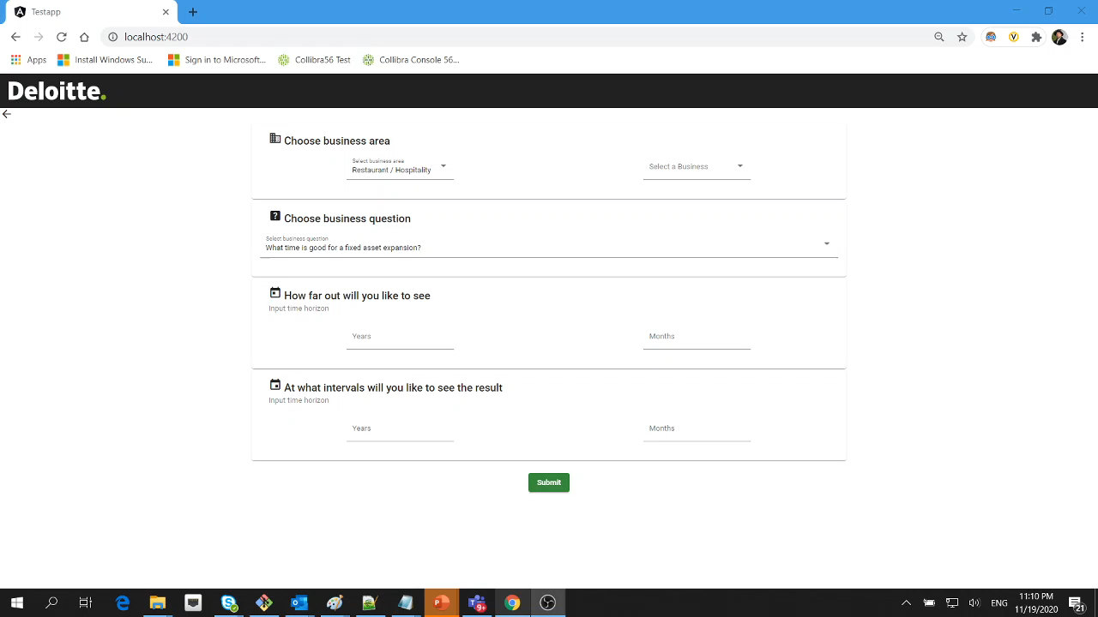

Slide 19
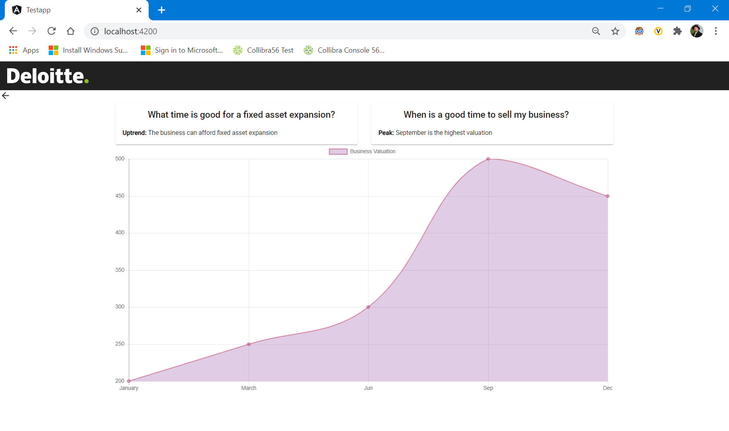

Slide 20
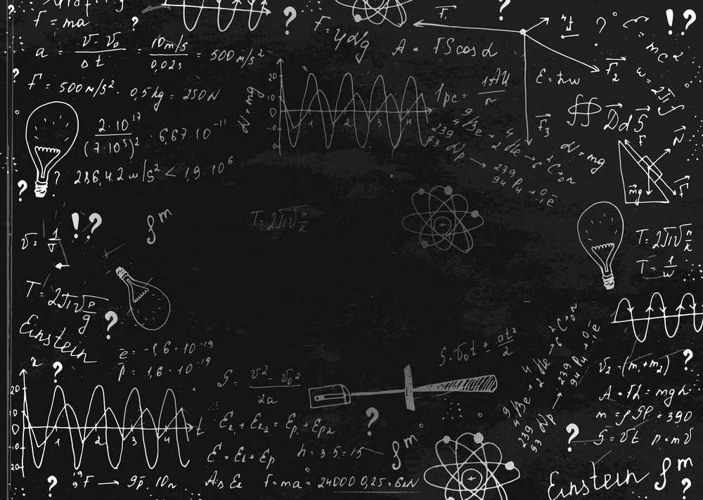
Is it clear now? Buy low, sell high
The best time to sell your business…
will be in September

Slide 21
So how did we do?
Reliable data must be easily available
train models
The product must be sellable
economically viable
The business case must be simple
realistic implementation
The product must have longevity
long shelf life

